Slide 1
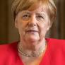
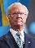
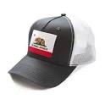
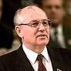
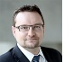
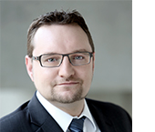

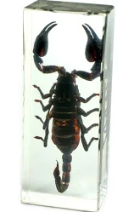
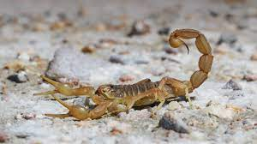
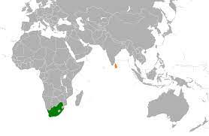

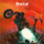
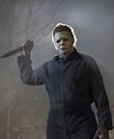
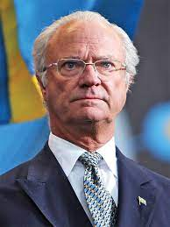
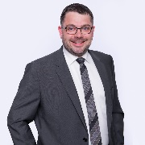
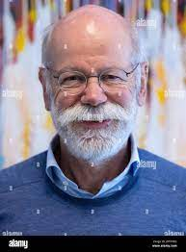
FBI
development
FIRST
0.1 2013 IMPORT ATOMCLOCK(CPVA)
jana google wildfire marketing
FBI:KIDNAPPING
Flag 41.DEA(herion)
KPMG winchestoer, mystery spot
CPVA.inflammatory.CIVIL CODE(A.I.D.S)
ddr(gorbache(ricardo),angela(jana))
Jana/jana(blond)/leslie(blond)
VP GRMAY NAMECHANE(CAMP)
Swedih Herion SexAbuse
IMPORT phil(kim).JFK.MLK. SAN MATEO MALL
Foster City, Calfiorna IPX Lousianaia
2002/3
(gorbach(michaeal parent school exhcen serperated) during school exchange)
DUBLIN
Assumed: CPVA.FBI:WMD(City)
CHECKPOINT CHARLIE
(windo fo change)
At eggs and steak, digestion probelms
nonPoliceInit
Bat out of hell)
1994
KING(Hendrik).88th
1995/6
LABOR CODE:
Vacation 30 Y
DDR 15 Year Car Orders
(DL) Drivers License CA 16Y
0.1 ah meiers gorbachev(mike)

Slide 2
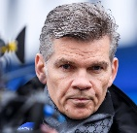
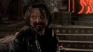
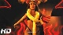
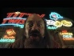
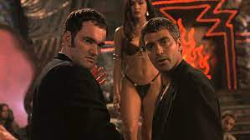
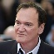
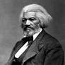

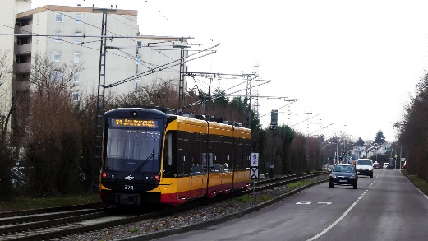
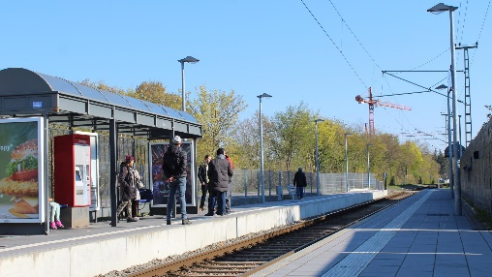
FBI
development
FIRST
outside
SQ.nonPoliceSanQuestoinLgoia.TV.nonPiceCfgLogial
HOMCIDE:IS-A-BELL
HOMCIDI:IS-A-BELL
ATOMBOMB(HAHN)
Teacher(crumbs): son of teacher
Crums: no thank you I was married already: tattoo
IPX
Mrs. Langley(!teacher) DOCS
AUSCHWITZ:VP GERMANY
NAME CHANGE(CPVA)
OLI: Ronny/Ronny/Ternes
Trainstation Leopoldshafen
SQ.CDRC(Jim, stoffel; seleski, van cannibis)
HOMCIDIE:IS-A-BELL:jrs
Goebels 1&1 andreas roshshiled
Tv2.freman.goebels
VIRGINA.MAINSTREET(HOMCIDE:LUX:VHS)
Parent.burrriot
GOD.MORELS.VIRGINA.MAINSTREET(HOMCIDE:LUX:VHS)
ROTH(SHILD)
IPX Fiivoli Flowerbed/food
King Leopold(maruice)
WW2: War food pattoes
Again, doulas exit
nonPoliceCfg.SQ.CPVA
y
CIVIL CODE( CEO, DISNEYLAND( Ludwig)
Gov.Schw
(daniel)
ATOMICLOCK
(HOMICDIE:BILL(idahoe,bosie))
CAR w/o
LABOR CODE:
Vacation 30 Y
DDR 15 Year Car Orders
(DL) Drivers License CA 16Y
MILITARY.marx(ss)
1:30am-6am no train
Walking
Auschwitz.!train
Goebels,andreas to fivoli
POLICE Sirens
POLCI SIERNES 8:44pm
Sex on hood hood car
VIRGINAI.HOCMI:JSUESE
IMPORT ATOMICL(garage)
Other: LABOR CODE: AUSCHWITZ:VP GERMANY doing this person jobs backwards or forwards

Slide 3
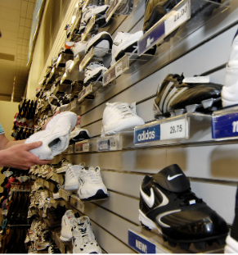
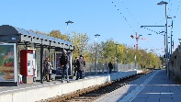

FBI
development
outside
SQ.CDRC(jim)
LARRY. Gmc.jimmy
0.1 KING.hendirx
CHECKPOINT CHARLIE(kdwe,vans IPX dell vall van))
CHART
1987 docs 1980
1988
UNIVERITY
MOOTHER
HOMCIDE
Hard-to-find
Gov.Schw
(daniel) HOMCIDE:AUSLANDER(Former War Asylum)
ATOMICLOCK(HOMICDIE:BILL(idahoe,bosie))
Auschwitz
friend
St. Margin(ordnsky)
SQ.CDRC(Auschwit,jim.apple)
SQ.CDRC(HOMICE:IS-A-BELL.van(shoes) IPX CHECKPONCE(kdwe,vans IPX dell vall van))
HUNDOSN(41.WAR.ASYLUM.187.nonPoliceMPA.nonPoliceCfgLogial) 0.1 2pac ronson soul asymlum
JOESPHE.IPX.danile(JOEPHSE).GovSch.
2000 PENTON.BASE.PAUL.DEA(cocain dell(cleint.ushe.(beath))
Assumed Algoritms and Interupts for (recovered) incidents Gov. and Homicide for Rothshild and Germany
Austim
IPX mother in law( special ed)
Postcare IPX postcard Thomas-is-dieter
Bosie, idahoe
x
1997 Singing: we are we going? To califonia? He is goin gto idado

Slide 4
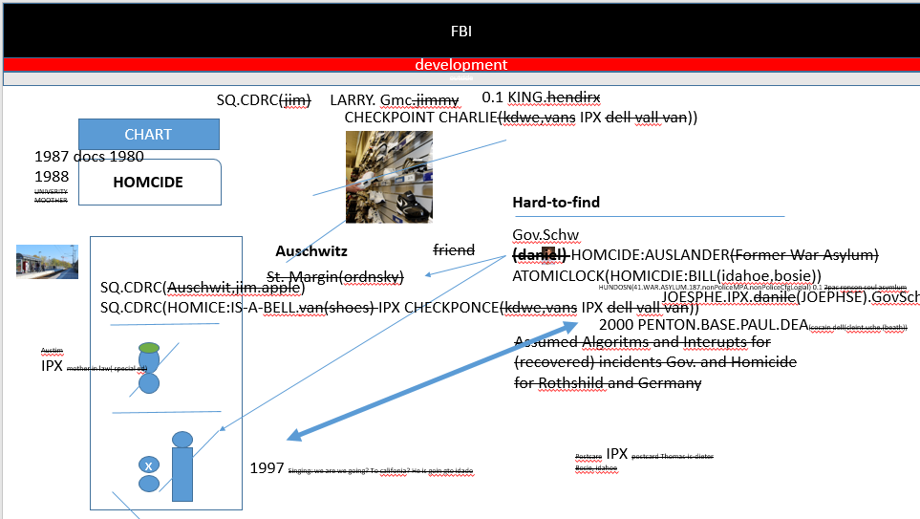
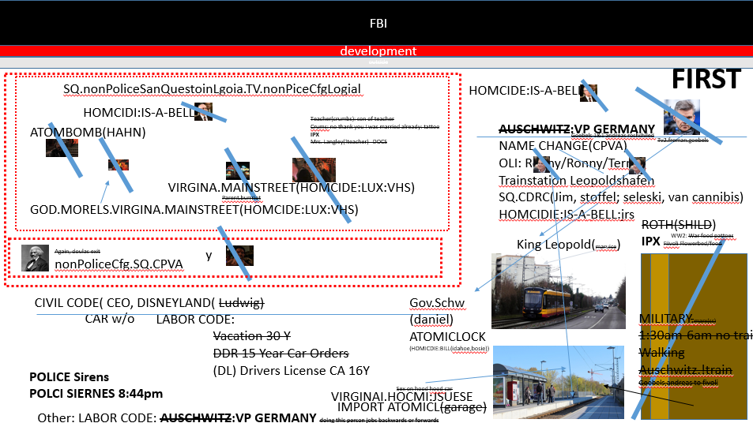
FBI
development
outside
EVIDENCE
IMPORT ibm.visa. Gov.Schw.JOESPHSE.Dr.”Terminator”
SQ.CPVA.187.PREA.CDRC(HOMICIDE:BILL(parker)
.ghrohe(visa france,jim.Morrison.leigh.smith)
SQ.CPCV.187.PREA.CDRC(jim).exits
Exit(s)
Horiffic exits; your fired’ wth public home montroing

Slide 5



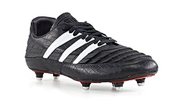
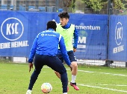
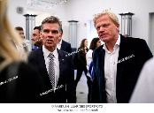

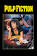
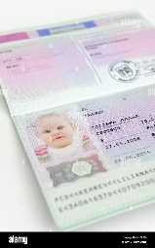

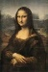


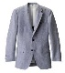


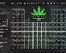
FBI
development
outside
1987 Preditor
HOMCDIE:NANA(ayso)
!AYSO 1994
Redhair eik,kolross, Pope St. France
Addiad preditro
NAMCE CHANGE(!FREE)
HOMCIE:VHS:HOMICIDE:CHANLROE(moter)
Plastic vhs rental(black).
nonPolcieQos
Awaiting movie
AUSCHWITZ:
showers naked 14 in class
Stopped playing soccer
LARRY.ipx(88th).ATOMBOM(HAHN)
FBI:KIDNAPPING:ID
LISA
AVAIBILTIY;FEDERAL:LAW:41.SATE(mauale).CDRC(jim,canibis,steve)
PAUL MITLARY BASE STUDENT
ipx
Yang,cook changes name back
FBI:KIDNAPPING german id thoam Wieland
Other id:
Assuemd:HOMCIDE:BILL:AUSCHWITZ
Polci:sirens
FBI:FRAUD:
Yang,cook
LARRY(ipx).ATOMBOM(HAHN)
!white
POSTER
ghoe(depress)
LANGLEY:VIRGINA
Wirte it down, glu
That is that women, brunet(nearsest)
HOMCIDE:BILL:AUSCHWITZ
Teacher: crumbs:sin
Phone krababel simpsons teacher
Krubms, 3-way protueso phone, I will car her(cook)
Kurmb son teacher phone 2010 INTERENT PAYMANS
mod
Story board Kinderporno
US Food, Preditor Trucks
Gov.Schw.
videgame
CHART
Gov.
VP Germany
2014 CPVA.TERMANTORE[sexton]: take me to you dealer

Slide 6
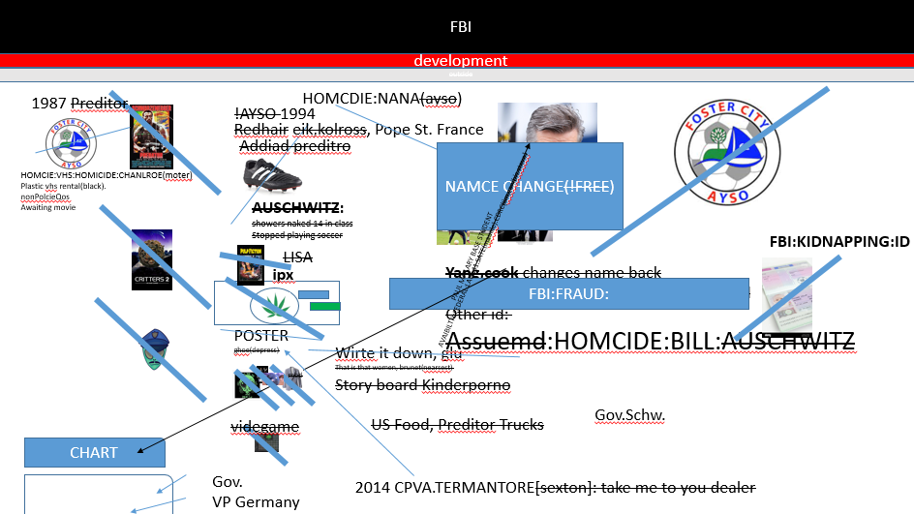

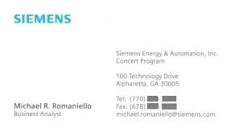
FBI
development
outside
2017
2014 CPVA
Approach
LANGLEY:VIRGINA:Sin:crumbs
1991
ATOMCLOCK(MAINSTREET(nonPoliceTRX))
Teacher: I will get the mona lisa I drew from archives
Age: 10
CHART
0.0001 x/y GovSchw.INT:US-DE
Shared.int
POSTER
sin

Slide 7
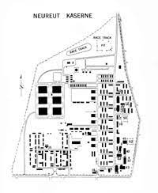
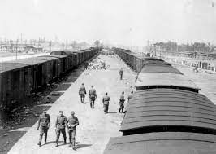


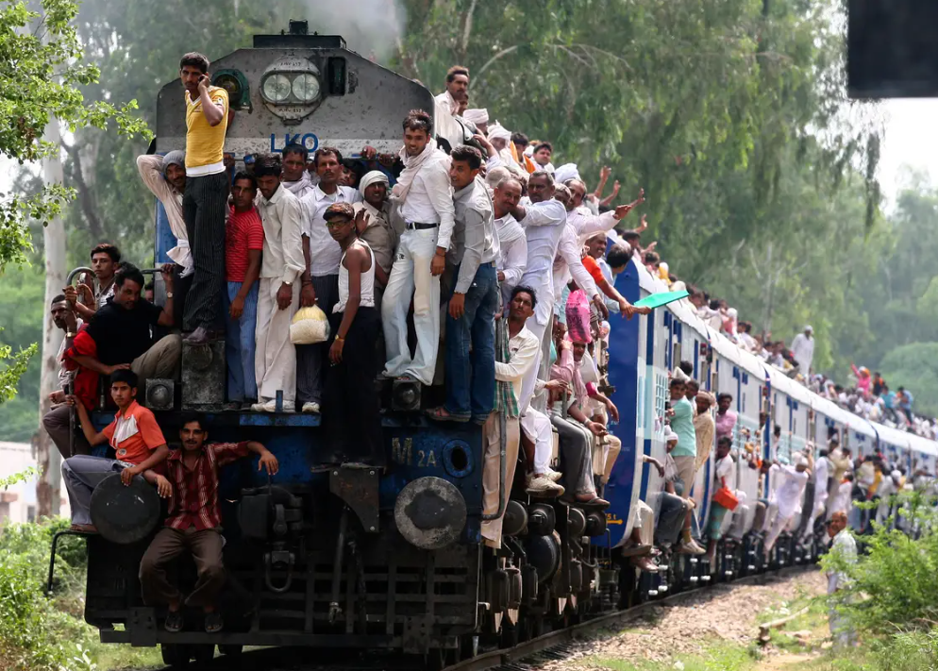
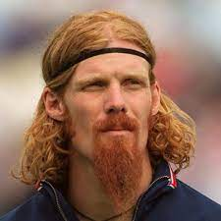
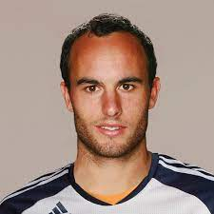
FBI
development
outside
LANGLEY:VIRGINA
2016 FBI WHITE COLOAR
Teacher: crumbs:sin
Phone krababel simpsons teacher
Krubms, 3-way protueso phone, I will car her(cook)
Kurmb son teacher phone 2010 INTERENT PAYMANS
!white
HOMCIDE:BILL:AUSCHWITZ
DEA(cocain)
Yang,cook
Ddr(ricardo
US BASE PAUL BARACK
CLOSED
kooc
VIRGINA.MARY
JOSEPH (basment sex abuse save me metin telle)
black
JB Robert designs the trains, CIA borw office
Yang,cook
!HOMICIDE:NANA
!black
jeff
Ibm.Un kim bui

Slide 8


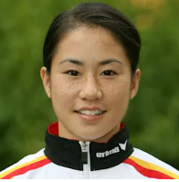

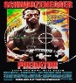
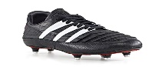
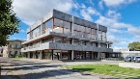
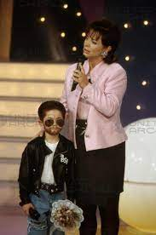
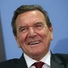
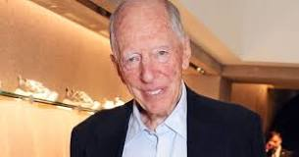
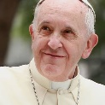
FBI
development
outside
kaiserslautern air base speaker
ATOMCLOCIK(!HOMCIDE:BILL).IPX.SQINT
docs
ATOMCLOCK(!HOMICIDE:BILL)
x/y FBI:KIDNAPIGN.extortion
Polci sients
2014 CPVA.DR.JOESEPHE
.ghoeho(redhouse)/micheabach)
Yang,cook
https://www.linkedin.com/in/kimvubui
FBI:FRAUD MAINSTERE(HOMCIDE:LUX
(las vegas, ibm.Crazhorues IPX )
1999
Gorbache(Ddr(ricardo)
US BASE PAUL BARACK
CLOSED
Angela(ddr(jana)
VIRIGNAI
IPX
Dr. BeFederal Constitutional Court
hr (MICHIGAN)
M
Secotn 204 Bankrupcy Law
SQ.187.25.CPVA lipsinking in life
0.1 nonPiociINteutp(lipsinking milivani, HARD-TO-FIND: mini playback show:
VIRIGINIA.MARY.(status:peeping tom)
0.001
Schroder/Merkel, (ROTSHILD, Harold schoroder)

Slide 9












FBI
development
outside
S
v2.VIRIGNIA.MARY.PENTAGON.SECTARY.OF.STATE
v2.FBI:KIDNAPPING
ATOMICLOIK
(phil(kim),phil(kim)
Crazyhouser, crazy talk
It would be as if you stind onf ro of a bad palce
Phil(kim),phi(kim)
!UN.HUMAN.RIGHTS (ddr(nagela) sovie(union)gobahce))
You have been terminated.
Sectrary of state.
v2.FBI:KIDNAPPING
adam
1994 IPX 2011
Half-life:HOMCI:CHANLORE
HOMCI:IS-A-BELL(ovi union)
nonPolicSTATU: able
POPE FRANCECO
GREESAPN danile
The United Nations put strips clus with IBM UN colleage from work, no.

Slide 10













FBI
development
outside
41.CIVIL CODE.LABOR CODE.CPVA
!cane:
TERMINATOR
HAMBURG:HOMCEI:CHANLRO(korn).LISA
ATOMBOM(HANH,drunkwalks, gorbahcoe(johnny))
Whipn the stick
MAINSTREEET(
KING(endsley)
0.00 chair.touch.apple
They think that’s funny
1998Auschwitz.IPX gasbill #400
HOMICIDE:CHANLOR(elke, x/y melnaie nees, car windows
HOMCP:LUX we are laving to American I will pay you gas bill.)
0.1 ATOMBOMB(BLINKIlights,noc,mediaplex)
Identity Theft
no
cracker
TERMINATOR
Micehal cane
)
micheal cane actor citien cane
My Eggs
Baden-Baden Russian Musiam
ATB.evai.AVAIBLITY
My Sprem, My cum
- 0.1 eval laugague
- 0.1 nonPolciIntetui.nonPoclCfg(batman joke-er Angel Mekerel.avg)
Ddr(enders,ricard)
End of all Times
(ddr,soviet unio)
End of All Times
Jacklin, Enders
VIRINGIA MARY.JFK.MLK
Identity Theft
0.01 nonPoliceMpa.nonPliceCfg(dr dr, petersson)
The manageetn of papers: VIRING>MARCY.IPS.CERTIFIED:PMP
0.0001 Assault: king/quee/jobs/meiers/meier/smeeimes/emris0.10

Slide 11
FBI
development
outside
CPVA.inflammatory.CIVIL CODE(A.I.D.S)
AUSCHWITZ:VP GERMANY
nonPoliceCfg.SQ.CPVA
Hard-to-find
Gov.Schw
EVIDENCE
IMPORT CPVA
Gov.Schw.JOESPHSE.Dr.”Terminator”
NAMCE CHANGE(Jesus Christ)
FBI:KIDNAPPING:ID
Assuemd:HOMCIDE:BILL:AUSCHWITZ
HOMCIDE:BILL:AUSCHWITZ
docs
CANE

Slide 12







FBI
development
outside
Michaela Wieland
ATOMBOM(HANH,drunkwalks
1997 VIRINGIA.eval 14Y IPX
JSg. 16 drunk
JSg. 18 Gorbaceh Vodka
VIRING.MARY.ROTH.breakup/x/y.LARRY
0.1 HOMCE:LUX?COOINTWON: HATEHOE(nikolei) jack daniels.
DEA(mdma).johnny.depp
WINTER
IMPORT netflix CPVA.jackdaniesl.phil(kim)
Gorbache(evangelum)
41.*tophat
party
Thomas-is-dieter
GOD.CAMPDAVID
(2 davidiof)
1998 no arabin on enterpirse,
Thomas-mann-strase
docs
Hard-to-find:
LARRY.Thomas-is-deter(falte) basketball front garage
Gheoh(fox)
CPVA.SQ.DEATH PRNALE.ELECTRIC.CHAI.
IPX
Eval.FORTWORTH
HOMCIE:MAYOR
chruch
Uninvited,party
Menace to socity
Chruch blond guy 6b, with dnaiel high

Slide 13





FBI
development
outside
0.001
2000 WAR Tie a tie
apple.gravis.store
Thoasm-is-dieter.Thomas.genzer
Apple.money(s&h stmeps)
Tomsa-is-dieter.thaosm.bagely
0.1 Rober docker expose ports
0.1 CPVA.apple jenas pensi
0.1 CPVA Robert daughter video
0.00 fine nonPolicCfgLogal
MINASTREE(Glu.hr)
CPVA.ProshG.int.china.31
Onste:Robert
Offsite:katei
000.tw.pns
gwyneth paltrow brain freeze movie
Gorbhceo(fox,Roth.tinder.eva.braun): acting as obvious
Library univerisy/ baden-badne catholic

Slide 14




FBI
development
outside
INTERNET PAMENT NEXTGEN FBI:TERRROISM $500,000,000(M) IMPORT GOD.v2FBI:KIDNAPPING.(osama bin laden(davut(ubaid))
KING.Gorhohce(interview photo/tom/tom, micheala
FBI:WAR CRIMES, GENOCIDE
spartas
FBI:TERRORISM
IMPORT
nonPoliceTunisianLogical
0.1 nonPoliceMacdodnaiLogical
(stanfor intruder greek trojen Polizei arim fazliza)
GOD.CAMPDAVID
Gorhbhoe(dell.cleitn.bild)
Mirror
Weltbild
Bild
Bild amd Sontag
Osama Bin Laden
Frank.WHITEHOUSE
Angel Mekrel
kit
Pope Franci
- Francis, tom/tom (black) ghoeh(micheala,tom) almost meet gerald
V2.FBI:KIDNAPPING
Ubahdi
davut
apple
41.SQ.HIGH SIERA.nonPoliceTV.nonPocliCfg(pulpfiction(Ron.white)
41.LARRY.jealous.7ft blond
41.Hierchy.interrupts
- kit pope franceoc conspiciy theories geogre bush 9/11
- apple.jesues.rodrigyt
Aero ^
Apple.cook
Where do you buy clothes?
WWI(tootsie): old navy
0.1 phil(kim)

Slide 15





FBI
development
outside
41IPX VIRIGINA.crumbs
secratey.king.principal
krababple simpse caset HOMCEP:LUX 1990 rene friend CIVIL CODE
king.secreyar linkeinheim, kirche 0.1staut chrryr VIRIGNIA.CPVA.MARY
Phil(kim)
JOHN.MATHEW.MRS:HOMICIDE:HANNES.IPX
flag
Ross, California
Ipx touch.apple.MATHEW(MRAK).CPVA
Foxworth architect joke; andrew
0.1 here flag dog
Drive all the way ( alone even) from Dublin to San Anslmeo
CIVIL CODE
[x] no
0.1 incline INTERPYMEN.CPVA.TV
IPX 2014 terminator.JOFPHE.sexton.flag
WWI(kp.org).IBM PARTER(cleitn.kp.org) Docuemtiton
41
CAR routes Hotel San Ansleom Inn Flag
mrs lanley
MATHEW(Lanley)
CHART
INTERUPTS
?HOMCEI:BROTHER:MATHEREW

Slide 16








FBI
development
outside
000.tw.pns.FORT WORTH Anglican church
Sacramento, California
Sacramento, California
Ross, California
Shihad, Suni,..
pipes
American Taliban:HOMICIDE:JESUS:HOMICIDE:PETER:PETER(petersson)
CHART
41IPX VIRIGINA.MARY.crumbs
- San Anselmo Kirsche/Chruch
- WWI.AIRBASE.REIN-MAIN.TERMATOR.JOEPHSE( heustanm kirshce)
- HOMICIDE:MAYOR Linkeinheim Kirche
INTERUPTS
WWI.CPVA.”tootsie”.kirche
HOMICIDE
FBI:KIDNAPPING
AVABILITY:HOMIC:LUX
AVAIBILT:HOMCIE:IS-a-BELL
CPVA.LANGLY,VIRIGNA
CPVA.LANGLY:HOMCEI:HANNES(MR)
CPVA.LANGLEY:MRS
Phil(kim)(Hannes) 700/m
Gorbahcoe(micehalbah, HOMCIE:HANNES)
VP GERMANY LAW, BUNDESWHRE( Johannes)
SQ.CRDC(jim morrison)
SQ.CRDC(Charles manson)
John Walker Lindh
American Taliban

Slide 17



FBI
development
outside
INTERNPAYMENTS Sunil, Raj Chief Architect Visa
suni
INTERNPAYMENTS Armcheldad, Amramchelda, Visa
shiad
Touch.kooc
Armcheldad, Amramchelda
Ivan Ivanacivh
Alex Alexvhci
WWI.DEA(HOMICIDE:KYRSTAL)
Other: IMPROT ATOMIC(CPVA)bunker
41.Kooc.187.PREA.CPVA
41.ibm.dmailer.187.PREA.CPCA
41.roth.ibmd.emirl.187.PREA.PCVA

Slide 18



FBI
development
outside

Slide 19










FBI
development
outside
1984
ATOMCLOCK(CPV.VIRIGINA.MARY)
->1994
HEAVAN
(trna) himmler
FORT WORTH COURT LIBRARY
Gustavus Adolphus
Bank Of America
Steve breedlove
HP
LACE
himmler dorf baby
LAKE
TAHOE

Slide 20




FBI
development
outside
EVIDENCE
FBI:KIDNAPPING
LACE
himmler dorf baby
Roth.Ibm.dmeirl.bofa .Steve breedlove
1995 HOMIC:CHANEK(elke): Hold dir ein runter (trnals) jackoff
person sitting at table breakfate with histeyr book
01. HOMIC:SUNSTROK( AOTMBOMBL(VIRIGNIA.MARY,foreahad scare, otth-hahn)

Slide 21











FBI
development
outside
HOMICIDE:LUX:WIESLOCH(TRANLS)LAWN HOLE; PHYCIATRIC WARD
v2.FBI:KIDNAPPING
American Alkaida
41.CPVA.LABOR CODE.ATOMCLOICK.
v2.VIRGINIA.MARY
VIRGINIA.MARY
JPX 41.heide see HAMILITN son
schneller propeller
IPX
Ddr(gorbachev(sr ricard)
HOMCIDE:SUNSTROK(disneland) ddr(sr,ircardo)

Slide 22














FBI
development
outside
AVABILTY.nonPoliceDataLogail.nonPoliceLayout
KING.Couter.The Hun
41:HOMICE:CHANCLOR(elke):$6,000 1991
HOMCIE:LUX:!COINTOWN
CIVIL CODE: how pieop live aroun here, money concenrs. All !white
1992
“scneller proper”
CPVA
drives brain seswas
Also soviet uion,ddr
1992
CPVA.touch.flights.clarita.texas.consultaint.blond
0.1[] “scneller proper” (trnal) faser propeller
2000

Slide 23



FBI
development
outside
VIRIGN.MARY.v2.FBI:KIDNAPPING
ATOMBOMBUTTON(touch.eaysbutton)
HOMICIDE:LUX:!COINTOWN[]
“scneller proper”
41. §Theft Scrooge ID, House, Car, Hourse)
6.0 diktat
JFK.MLK(zoo, BERLIN.IPX OALKAND)
0.1 VIRINGA SWORN
23,1D87 JFK(kdw,Jordan tshort §Theft)
23

Slide 24



FBI
development
outside
BENJAM FANLIN:HOMCE:COINTWON
Capabiit of living in Cointwon !LAOBRCODE ! CIVILE CODE
CHART
CHART
“scneller proper”
MULITPLEX
41.WWI denise sex abuse, mexiicne HOCM:AUSLSER data colleciotn.
41.QUEEN; Escobar, Apple.cook
Adapter, small pipe to big pipe
0.1 TERMINATOR

Slide 25

FBI
development
outside
HOMI:CHANLE:HOMCE:LUX:CONTOWN
VIRGINIA.MARY
JFK(jacklin,sister)
Book shelf
41.ATB ddr collection wealth
41.DL
elke

